Slide 1
BUSINESS MENTORSHIP SOFTWARE
PROBLEM STATEMENT:
MENTORSHIP SOFTWARE FOR BUSINESS
Team Members: Abhay Rajpoot (100180101)
Himanshu Gupta (100180164)
Jay Kumar Yadav(100180128)

Slide 2
IDEA DESCRIPTION
Book-keeping and Accounting software for Business – Software to be developed as per standard accounting standards and practices which will help the Business to view the overall financial position. This will enable the Business to take informed decisions related to expenses and also help Business in identifying activities which are generating income and activities which are loss making and accordingly in taking corrective actions. The software must also enable Business to pay various statutory dues and taxes on time with zero error.
SOLUTION
We are trying to develop a software which will work for the Business to view the overall financial position.
This software will set a target for the particular business according to the business expenses & other income activities.
This will help to monitor the profit margins and loss caused in business regarding specific activities.
The target would be set on the basis of overall income of the business and it will vary for each business according to its type.

Slide 3
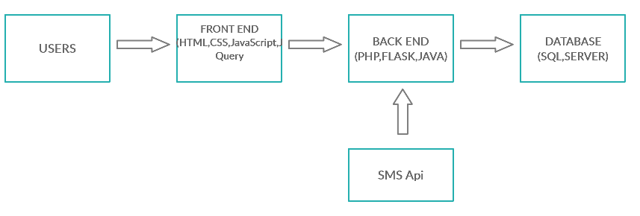
TECHNOLOGY STACK
USING LANGUAGE: PYTHON, HTML, CSS
Database: SQL
Editor: Brackets, Notepad++
CHARACTERISTICS
1. Connection between Business and Organisation .
2. Monitoring the business.
3. Estimated Report generation showing profit and loss percentage.
4. Predict Reason of lose and profit .
5. Give Suggestion for Take Decision .

Slide 4


DEPENDENCIES
BUSINESS EXPENSES
ACCOUNT ANALYTICS
TAX DETAILS
INCOME ACTIVITIES OF BUSINESS
TRANSACTION DETAILS

Slide 5
TARGET
This Target will be used to generate profit rate for the business.
Estimation before giving loan
ESTIMATE
(Profit Rate,
ROI Time)
PROFIT ANALYSIS
ESTIMATED
REPORT
After One Month
ACTUAL REPORT
ESTIMATED REPORT
PROFIT PERCENTAGE & LOSS PERCENTAGE

Slide 6
USE CASES
BUSINESS WILL REGISTER VERIFYING ITS CERTIFICATES
EACH WILL HAVE A SEPARATE INTERFACE
ADMIN CAN NOW EASILY MANAGE THE DIFFERENT BUSINESS THEY ARE SUPPORTING
THE ADMIN HAS TO PROVIDE EACH INCOME ACTIVITY OF THE BUSINESSES
THIS WILL HELP THE SOFTWARE TO CREATE A TARGETED ESTIMATE OF BUSINESS.
(The businesses will be categorized in a specific way)
(This estimate will determine the profit rates of the business.)
Through this Admin can monitor the running business's activities.

Slide 7
ER Diagram
Loan
Profit Rate
Business Type
Business 1
Profit/Loss
Target
Registered_id
E-mail_id
Organization Address
Loan
B_type
Login_id
Admin
Profit/Loss
Target
Control
Business 2
Organization Proof
Profit Rate
Bank Detail
Business 3
Profit/Loss
Target
Loan
B_type
Profit Rate

Slide 8
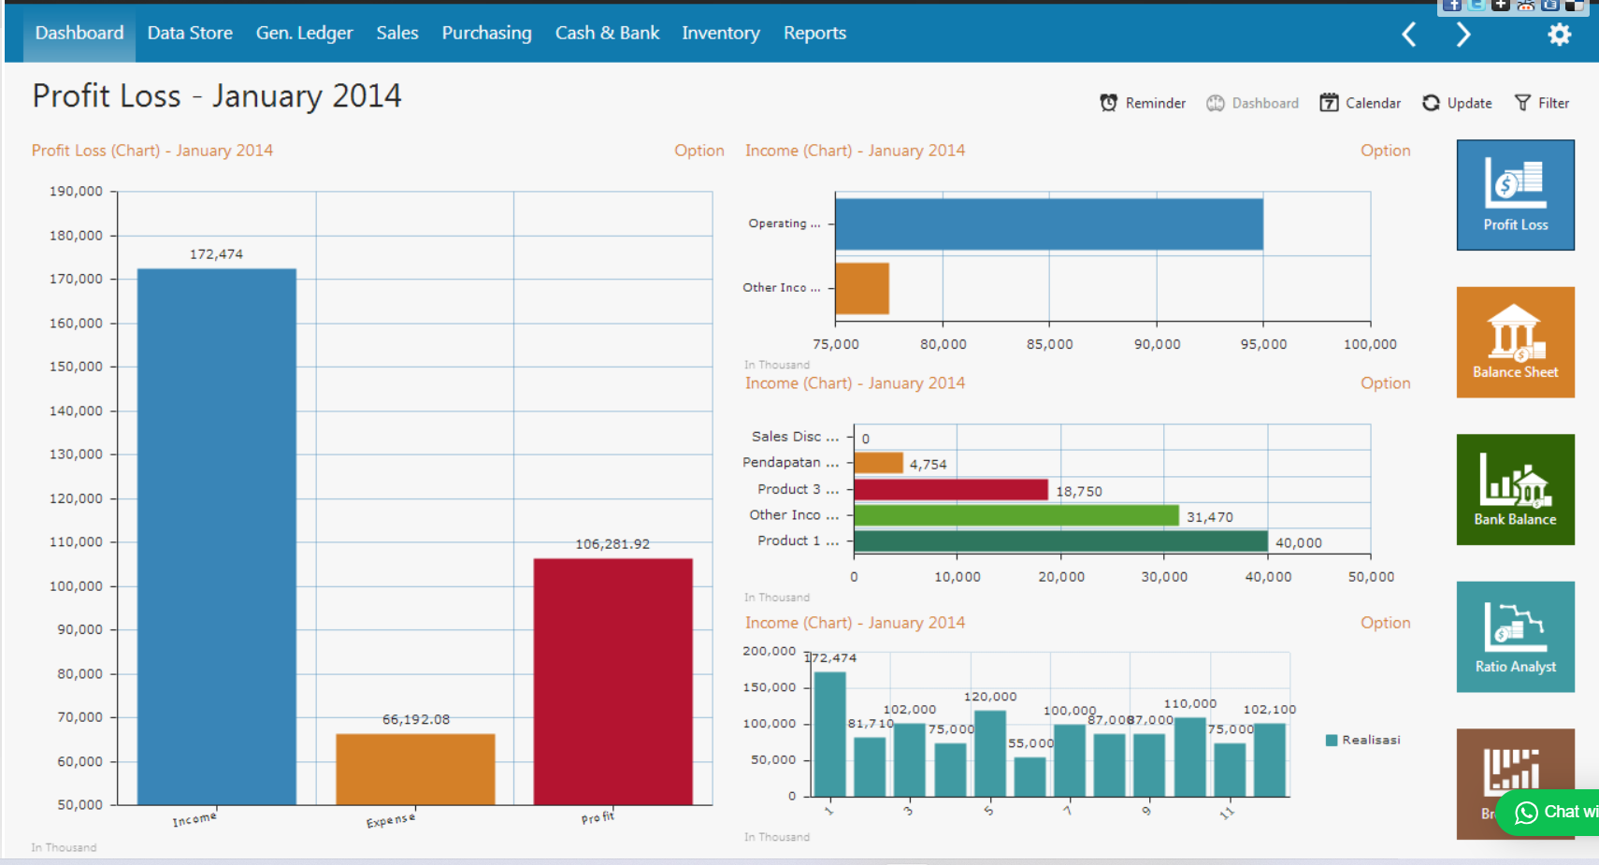

Slide 9
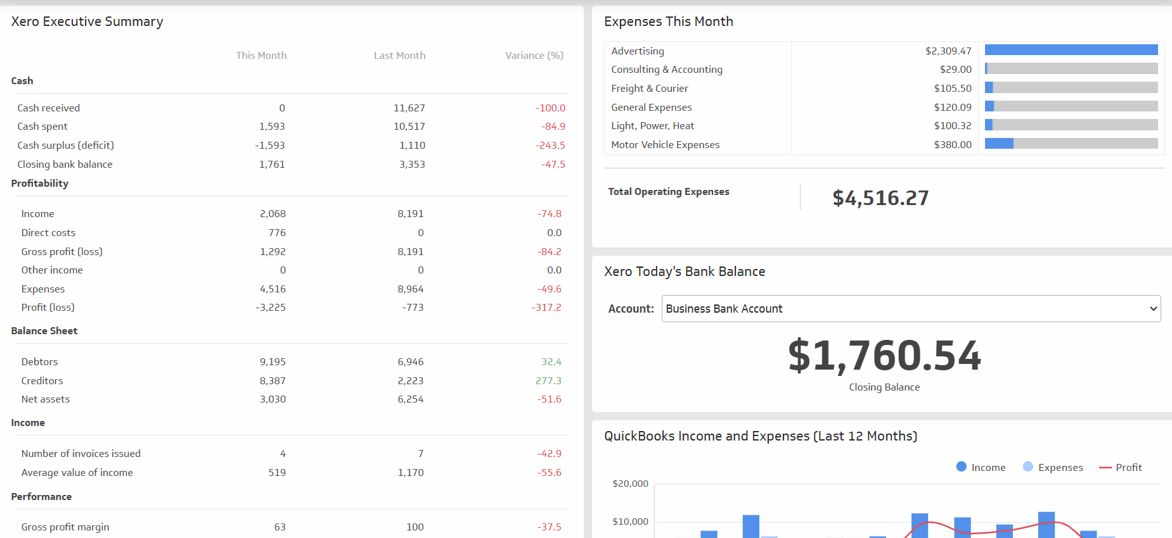

Slide 10


